Slide 1
On Enhancing Genetic Algorithms Using New Crossovers
By Bhavesh Ahluwalia

Slide 2
Title page
Name of paper : On Enhancing Genetic Algorithms Using New Crossovers
Bhavesh Ahluwalia
Affiliation—Queens College
Advisor—Professor Robert R Goldberg

Slide 3
Abstract
This paper is a survey on investigates the use of more than one crossover operator to enhance the performance of genetic algorithms.
In this paper, two sets of experiment have been conducted on different TSP problems; both were designed to compare the performance of the proposed crossover operators with the well-known Modified crossover and PMX crossover, using real data.

Slide 4
Introduction
The genetic algorithm was inspired by the Darwinian theory of “survival of the fittest” by producing new chromosomes through crossover and mutation operations.
In this study, author does several experiments on travelling salesman problem(TSP) with the usage of new crossover operator to evaluate the best performance of genetic algorithms. They found out, Collision Crossovers performed the best in terms of accuracy and time consuming, and this is due to the randomness of the collided genes that output offspring that are significantly different from their parents.
This study also shows that using more than one crossover method in GA can enhance its performance, because it allows the GA to avoid the local minima; the proposed SBC and SAC strategies enhance the performance of GA.

Slide 5
Background
A genetic algorithm is a search heuristic that is inspired by Charles Darwin’s theory of natural evolution. This algorithm reflects the process of natural selection where the fittest individuals are selected for reproduction in order to produce offspring of the next generation.
This paper involved different experiments and their results shows the importance of some of the proposed methods, such as the collision crossover, to the significant enhancement of the genetic algorithms performance, when they use more than one crossover operator.

Slide 6
Find better Performance of GA and Travelling Salesman Problem
In this paper, the authors investigates into the effect of using more than one crossovers on the performance of the GA. Secondly, author also proposed new crossover operators to find the better solutions for TSP travelling salesman problem.
The search for the best solution (in genetic algorithms) depends mainly on the three types of crossovers and then compared with the well-known modified crossover.
A lot of problem solving techniques were introduced by numerous people to solve the Travelling Salesman Problem. For example: Singh, A & Singh R came up with an enhanced edge recombination crossover a new way to solve the Travelling Salesman Problem. Ray S came up with an algorithm called SWAP_GATSP. it turns out SWAP_GATSP performed quite well compared to other methods that have been trying to solve TSP. Ahmed, proposed sequential constructive crossover (SCX) to solve the TSP problem.

Slide 7
Literature review
The work proposed in this paper uses large number of crossover methods in the literature to find out which is the best method to use to check the performance of GA. So, to find out the best method they implemented three types of crossovers which is compared with the well-known modified crossover . The three types of crossovers are the following
Cut on worst gene crossover (COWGC)
Cut On Worst L+R Crossover (COWLRGC)
Collision Crossover
I think by studying and combining these new crossover methods It may be possible for someone who can come up with new crossover method which can enhance genetic algorithm performance more and give better life to the next generation.

Slide 8
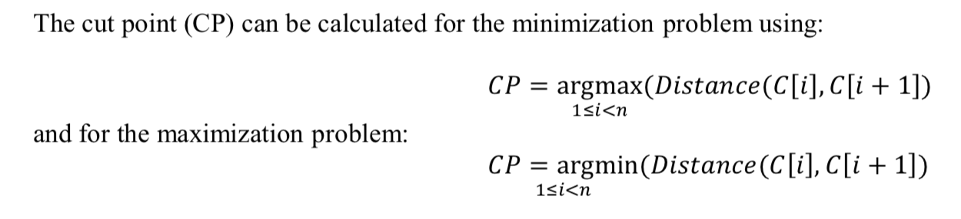
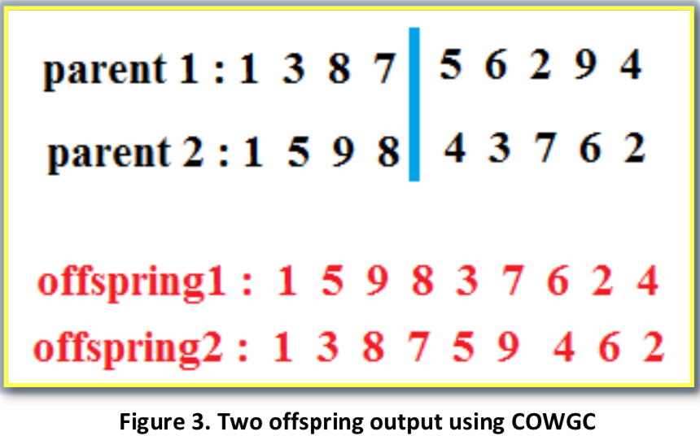
Cut on worst gene crossover (COWGC)
Method 1
The two worst genes are compared to get the worst of both; the index of this point is considered as a cut point in the parent that has the worst gene. The genes after this cut point of the two parents are swapped as in the “Modified Crossover” (Davis, 1985).
Step1: the worst gene in the first parent is 6, because the distance from 5 to 6 is the maximum and equal to 22 (d1), and the worst gene in the second parent is 4, because the distance from 8 to 4 is the maximum and equal to 60 (d2).
Step 2: using equation (1) the cut point of parent 1 is the index(6) and the cut point of parent 2 is index(4).
Step 3: If (distance1) > (distance2) then Apply the Modified crossover in both parents at index (6).
Else apply the Modified crossover in both parents at index (4)
(see Figure3 on the right side).

Slide 9
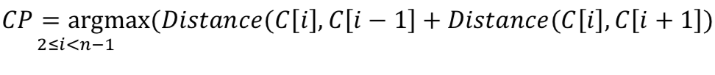
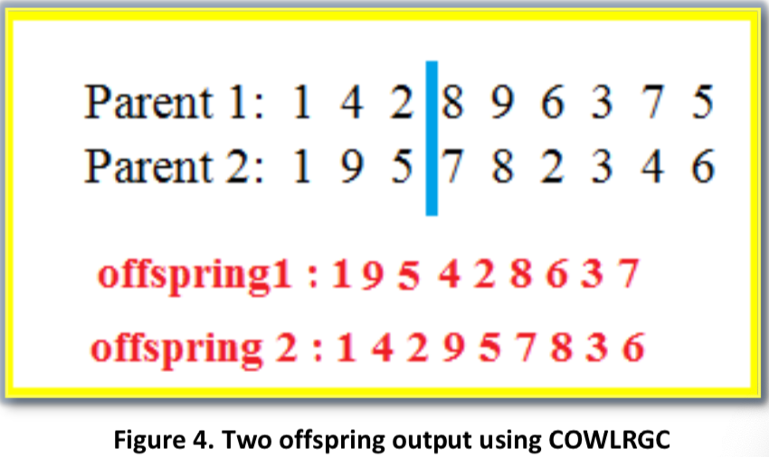
Cut On Worst L+R Crossover (COWLRGC)
Method 2
In this crossover method is similar to COWGC but the worst gene is found by calculating the distance between both its neighbours: the right and the left. The cut point can be calculated using:
Step 1: calculate CP1 for the first parent and CP2 for the second parent; CP1 will be at city “8”, because the total distance from city 8 to city 2 and from city 8 to city 9 is the maximum and is = 51 (d1). For the second parent, CP2 will be at city 3, because the total distance from city 3 to city 2 and from city 3 to city 4 is the maximum distance and is = 32 (d2).
Step 2: If distance 1 > distance 2 then apply Modified crossover for both parents based on CP1 (city “8”), to create two offspring (see Figure4). Else apply Modified crossover for both parent based on CP2.

Slide 10
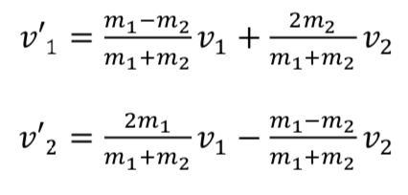
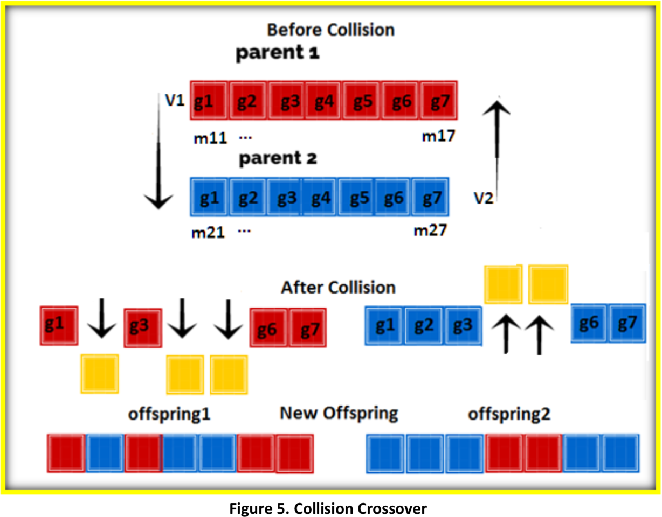
Collision crossover
Method 3
Collision crossover, which is based on the physical rules of elastic collision.
In Collision Crossover, the relation of physics is mentioned when it comes to the speed of objects moving towards each other. When collision occurs it can be calculated using where v is velocities and m is masses:
How this works:
if the gene is reflected it means it’s good and it’s a small distance from its neighbors so, it remain at same spot to form offspring (1)
Other genes which carried on moving in the same direction are removed from their places in the new offspring (1)
leaving gaps that need to be filled from parent 2. The same procedure is applied to offspring (2).

Slide 11
Multi Crossover Operator Algorithm
In Multi Crossover, they proposed using more than one crossover operation which can produce different patterns in the offspring which constitutes for diversity in a population.
Select the best crossover (SBC) : applied all the aforementioned crossovers (COWGC, COWLRGC and Collision Crossovers) to the two randomly chosen parents.
Select any crossover (SAC): Randomly choose one of the aforementioned crossovers (COWGC, COWLRGC and Collision Crossovers) in the two randomly chosen parents.
So, I believe that I could possibly make code the experiment. There is sufficient information in this paper that would allow programmer to code the experiment because the authors explain to us exactly what's going on in order to give the programmer the tools on how to begin writing the code.

Slide 12
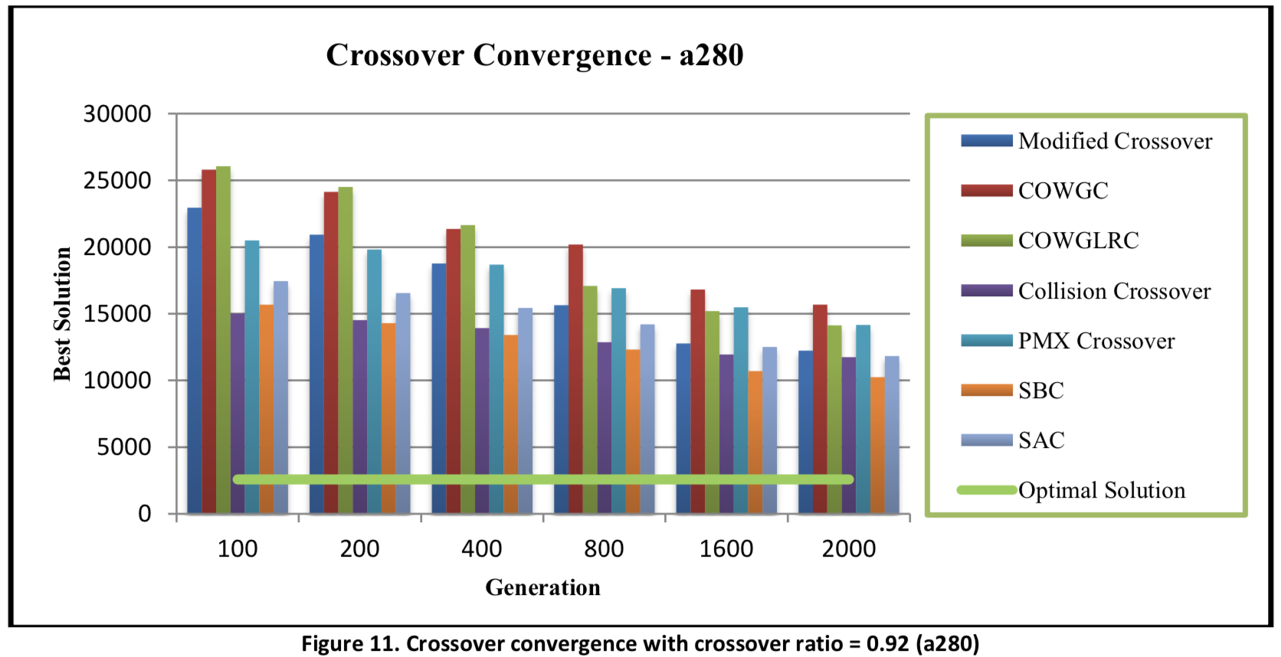
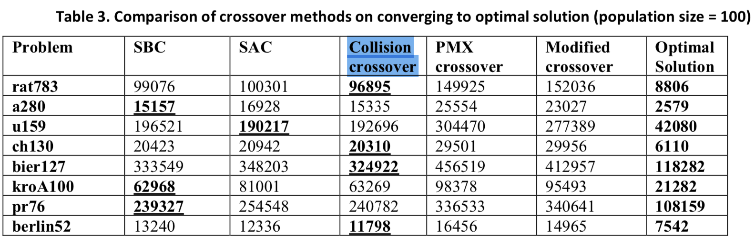
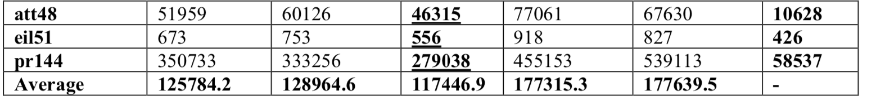
Experimental Results
After looking the results it reveals that the SBC algorithm outperformed all other methods in the speed of convergence.
The best performance was recorded by the Collision crossover, which outperformed the other methods in seven problems: rat783, ch130, bier127, berlin52, att48, eil51, pr144 followed by the SBC algorithm and SAC algorithm.

Slide 13
Discussion of the Results
To evaluate the proposed methods, they conducted two sets of experiment on different TSP problems and they both were designed to compare the performance of the proposed crossover operators with the well-known Modified crossover (Davis, 1985).
In the first set of experiment, they find out that the best performance is recorded by SBC, then by the Collision crossover and SAC. But SAC is still better than the SBC in terms of the time consumed, because SBC tries all the available crossovers and selects the best, which consumes more time. While the SAC selects any one randomly.
In the second set of experiment, main aim of those experiments is to measure the effectiveness of the SBC, Collision crossover and SAC operators compared to the optimal solutions. They results showed up Collision crossover perform the good performance. Although, solutions produced by the tested algorithms were close to the optimal solutions, but none could achieve an optimal solution.

Slide 14
Conclusion
In the paper author shows, how Collision Crossovers performed the best in terms of accuracy and time consuming. This study also shows that using more than one crossover method in GA can enhance its performance, because it allows the GA to avoid the local minima; the proposed SBC and SAC strategies enhance the performance of GA.
However, if we talking about the performance, convergence speed and consumed time they also found out the Collision Crossovers is the best choice for GA.

Slide 15
Future Research and suggestion
Author states that to enhance the performance of GA only crossover is not enough. Therefore, they will development of some types of new Mutations, using the same approaches, trying more than one mutation each time to support the proposed approaches and attempting to further enhance the performance of GA.
The suggestion I would like to make to author is to include some code so that we can see the Travelling Salesman Problem in action. This would enhance the research paper to a respectable extent and give the reader an understanding of what the Travelling Salesman Problem stands for.

Slide 16
Acknowledgements
I would like to thank, Professor Robert Goldberg who teach me genetic algorithm course in 3 weeks and also give me opportunity to enhance my knowledge through this assignment.

Slide 17
Bibliography
Ahmed, Z. H., 2010. Genetic algorithm for the traveling salesman problem using sequential constructive crossover operator. International Journal of Biometrics & Bioinformatics (IJBB), 3(6), p. 96.
Davis, L., 1985. Applying adaptive algorithms to epistatic domains. IJCAI, August, Volume 85, pp. 162-164.
D.E. Goldberg, Genetic Algorithms in Search, Optimization and Machine Learning (AddisonWesley, 1989).
Deep, K. & Thakur, M., 2007. A new crossover operator for real coded genetic algorithms. Applied mathematics and computation, 188(1), pp. 895-911.
Ray, S. S., Bandyopadhyay, S. & Pal, S. K., 2004. New operators of genetic algorithms for traveling salesman problem. s.l., IEEE, pp. 497-500.
Singh, A. & Singh, R., 2014. Exploring Travelling Salesman Problem using Genetic Algorithm. International Journal of Engineering Research & Technology (IJERT), 3(2).
Zhong, J., Hu, X., Gu, M. & Zhang, J., 2005. Comparison of performance between different selection strategies on simple genetic algorithms. s.l., IEEE, pp. 1115-1121.

